Slide 1

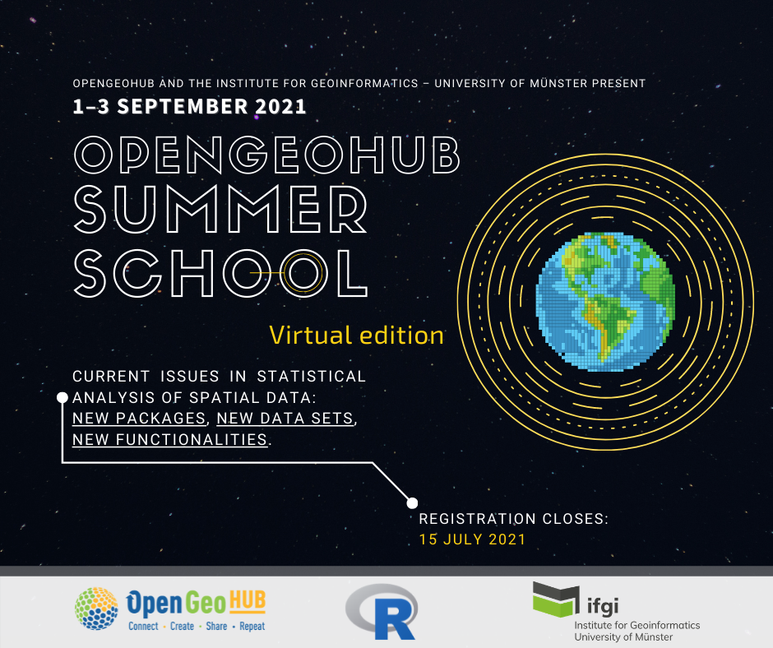
SITS: Satellite Image Time Series Analysis for Big Earth Observation Data
Gilberto Câmara, Rolf Simões and Felipe Souza
INPE (National Institute for Space Research, Brazil)

Slide 2

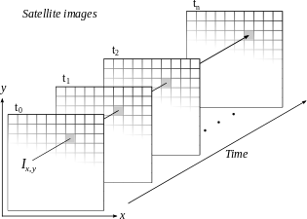
Space-first, time-later or time-first, space-later?
Space-first: classify images separately. Compare results in time
Time-first: classify
time series separately.
Join results to get maps
Notes:
A construção de um sistema para análise de dados de observação da Terra, dada as características aqui mencionadas, se depara com vários desafios e escolhas.
O pacote sits é baseado na abordagem “Time-first, space-later” que se baseia na classificação de séries temporais e se diferencia da abordagem “Space-first, time-later” que se baseia na classificação multitemporal de imagens.
Essa foi uma decisão que estruturou todo o sistema já de partida. O foco do sits é a série temporal.

Slide 3
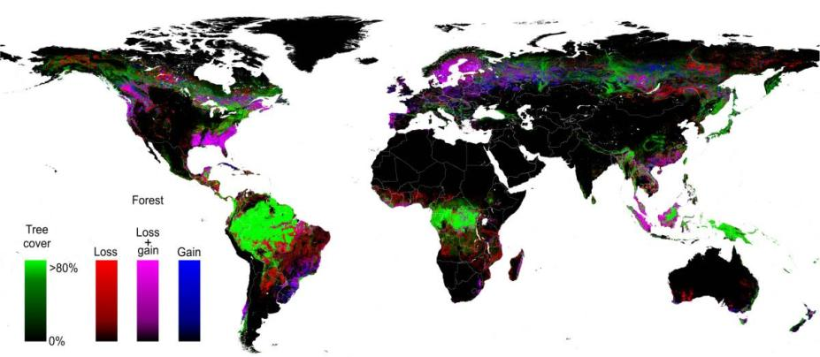
Human-like: compare two ”best dates”
Hansen et al (2013)
Find forest areas in images from 2000 and from 2010
Compare the results to account for forest loss
(650,000 LANDSAT images – 140 x 10⁹ pixels)

Slide 4
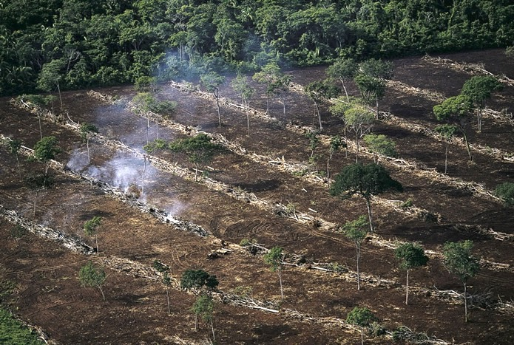
Two-date comparison: problems
Removal of natural forest
Cuts on planted forests
Two-date comparison does not distinguish between types of forest removal

Slide 5
Single-date measures lead to inconsistencies
MODIS 2000
Forest
GFW 2000
Forest
Disagreement in the Caatinga dry forest: date of image aquisition?

Slide 6
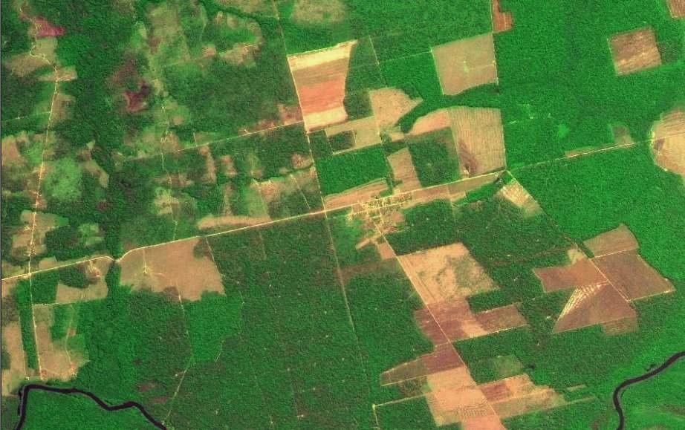
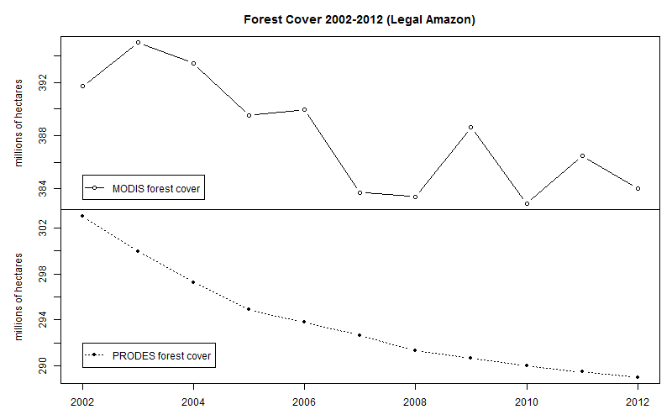
Two-date comparison: inconsistent results
MODIS land cover: unrealistic forest gains and losses
Data sources: INPE, NASA. Analysis by M. Buurman

Slide 7
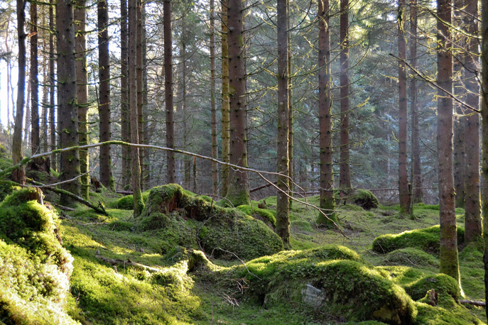
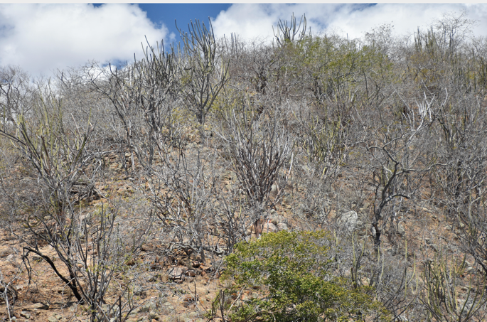
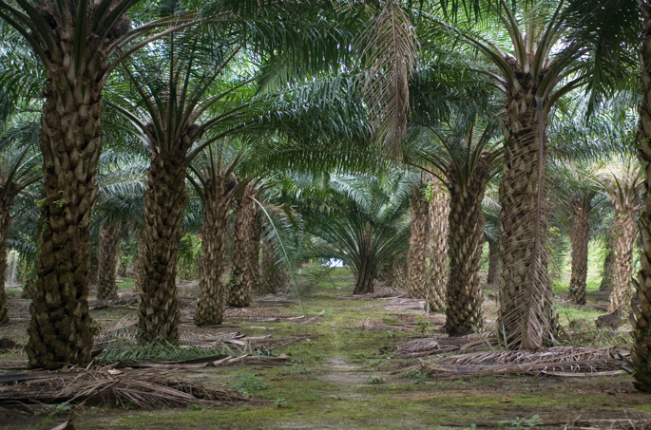
Tropical forest
Temperate forest
Dry forest
Planted forest
images: Alamy

Slide 8
Distinguishing forests by temporal evolution
source: Chazdon et al (2016)

Slide 9

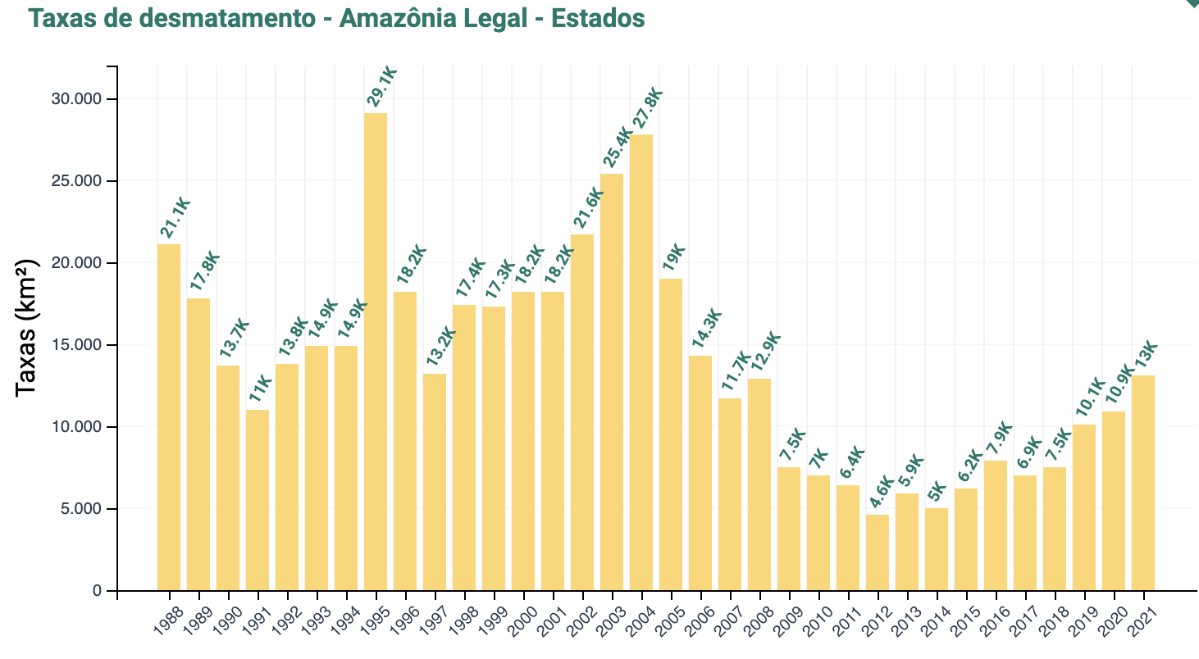
Deforestation in Amazonia: PRODES
Transparent and authoritative data: REDD+ funds (US$ 1,3 billion), decision-makers (Brazil’s NDC), researchers (1,000+ papers)

Slide 10
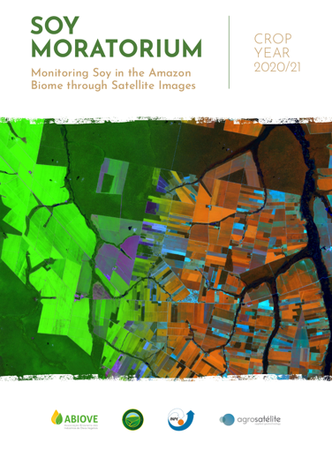
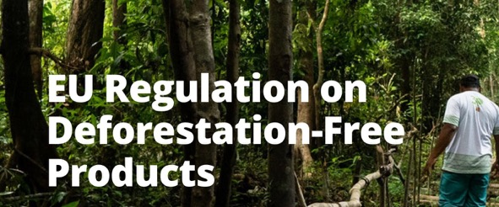

EO for compliance
How good must EO deforestation maps be for compliance enforcement?

Slide 11
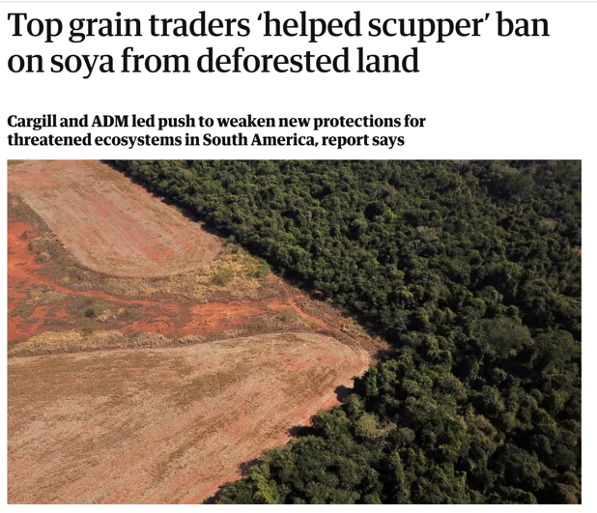

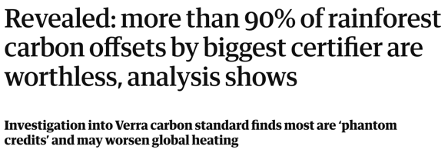
EO for compliance

Slide 12
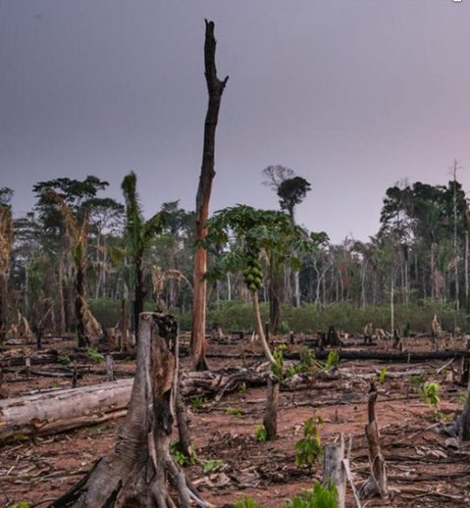
EU deforestation-free goods regulation
(31) EU Observatory on deforestation, forest degradation, changes in the world’s forest cover and associated drivers to better monitor changes in the world’s forest cover and related drivers.
What happens if the EU Observatory produces bad results?

Slide 13
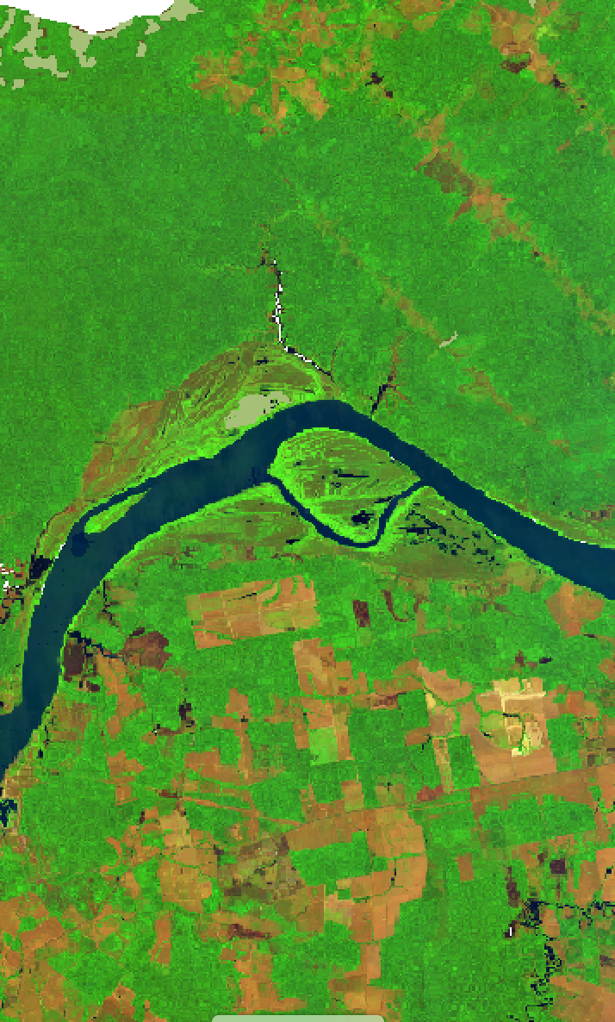
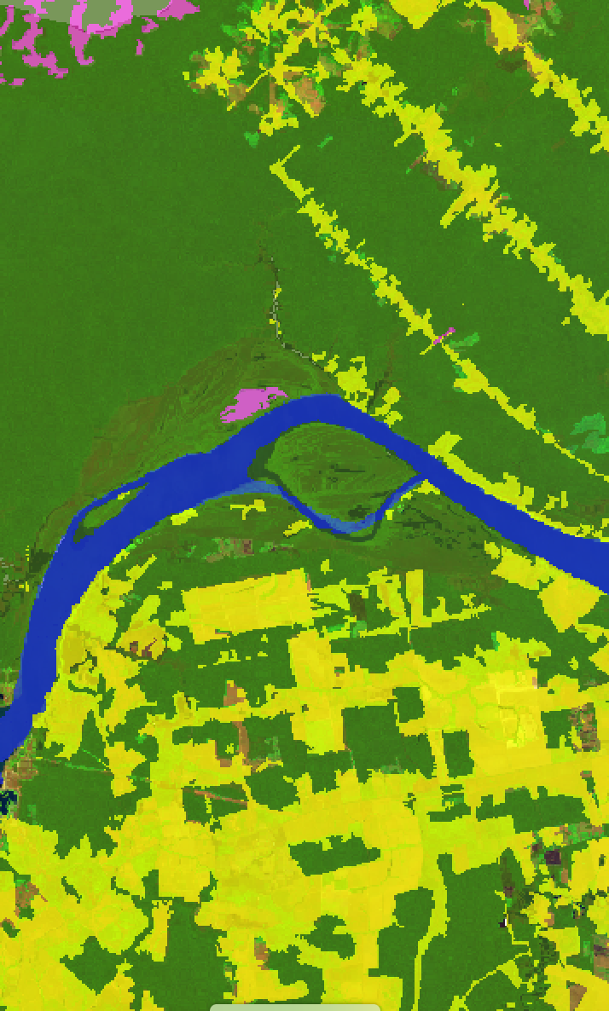
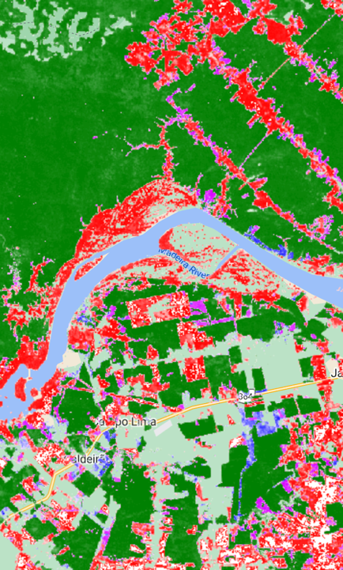
Sentinel-2 (2021)
PRODES (2021)
GLAD (2000-2020)

Slide 14
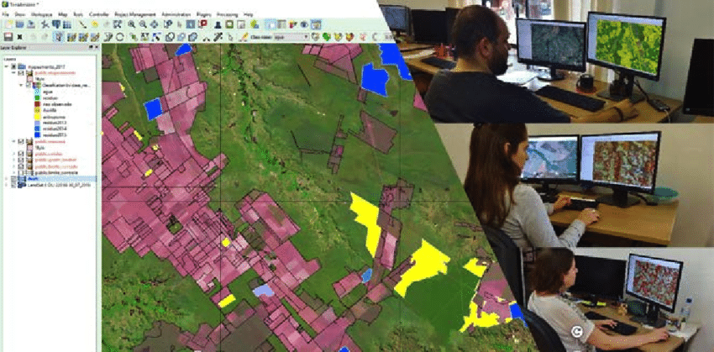
Visual interpretation is hard for ML to beat…

Slide 15
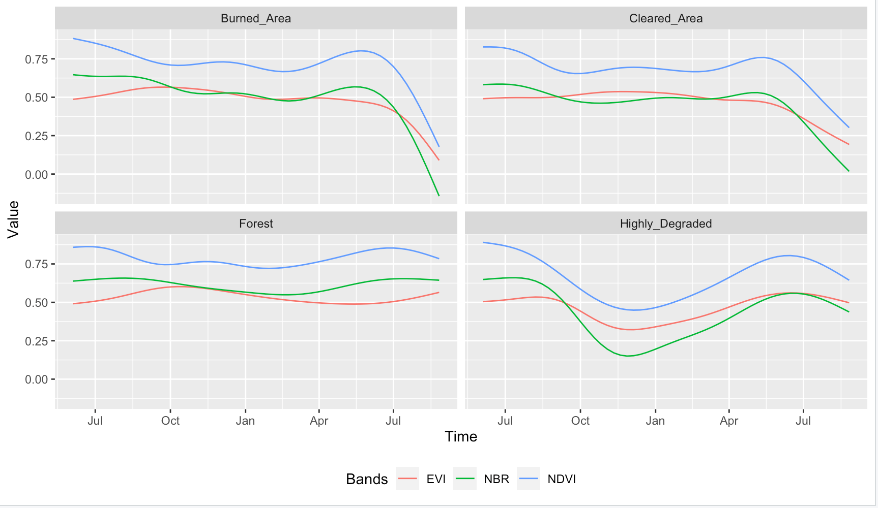
Event-based samples (model estimates)
Burned area
Cleared area
Forest
Forest cut with regeneration

Slide 16
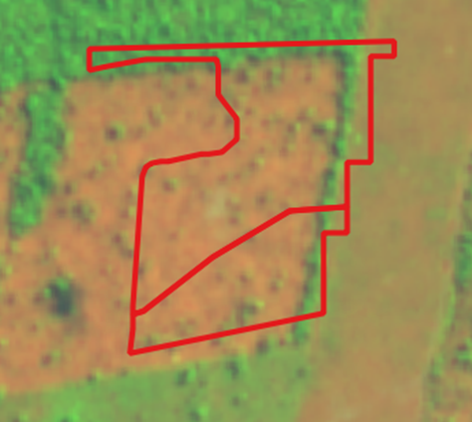
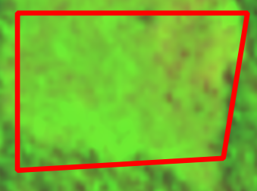
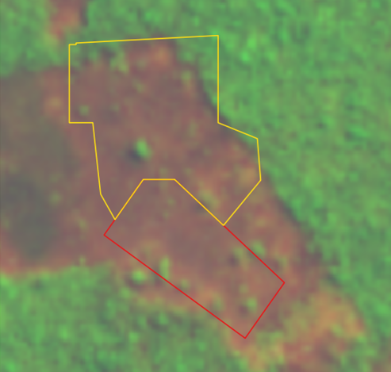
Clear Cut Bare Soil
Clear Cut w/ vegetation
Clear Cut w/ fire
How to measure these events?

Slide 17
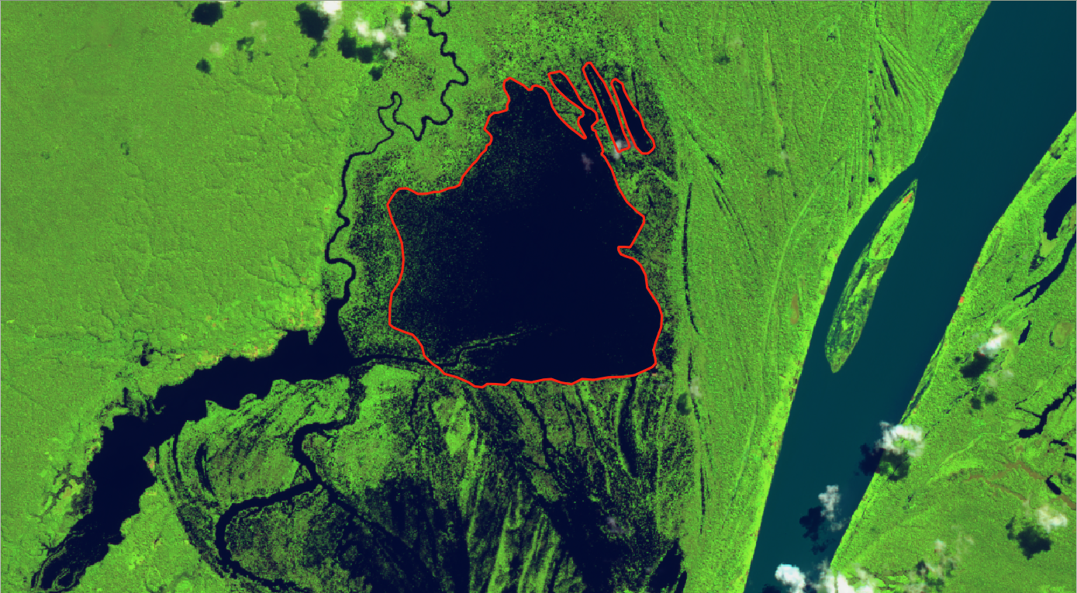
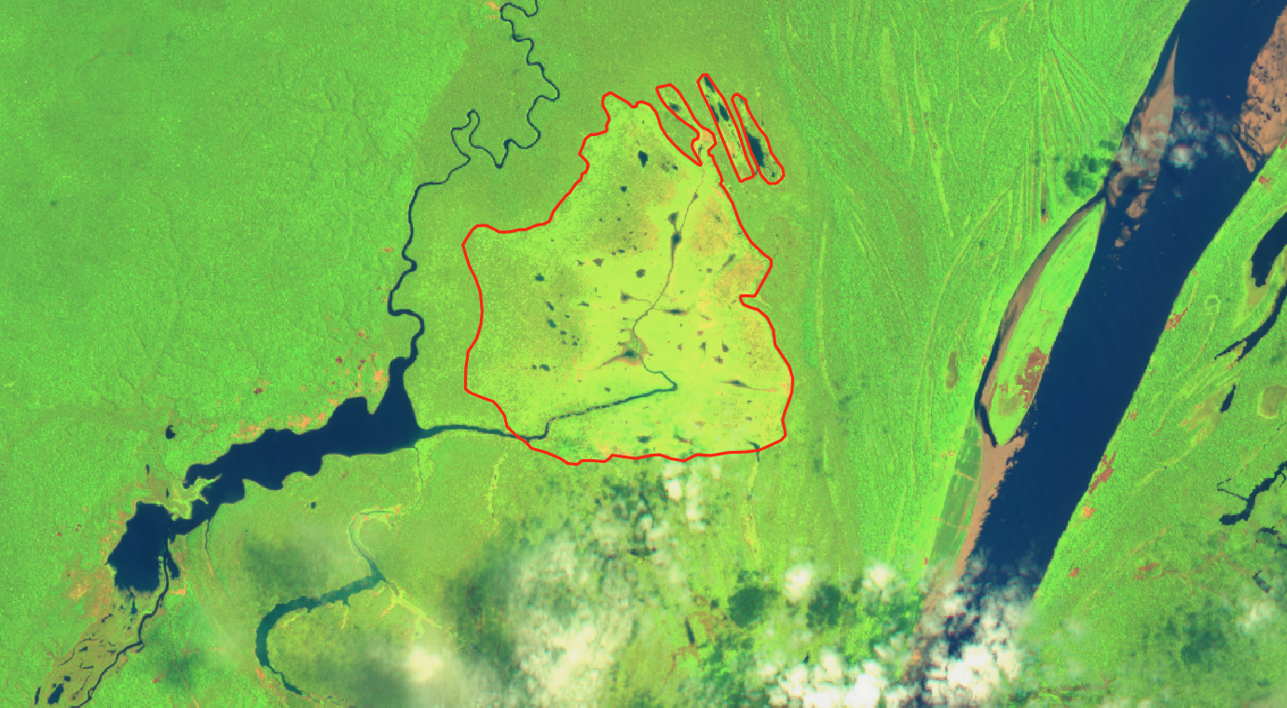
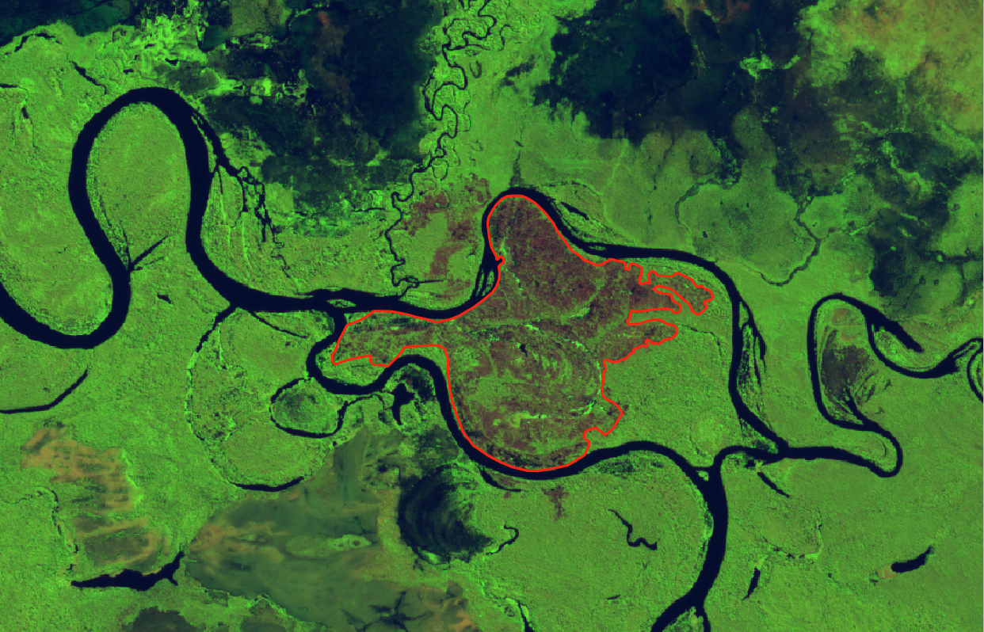
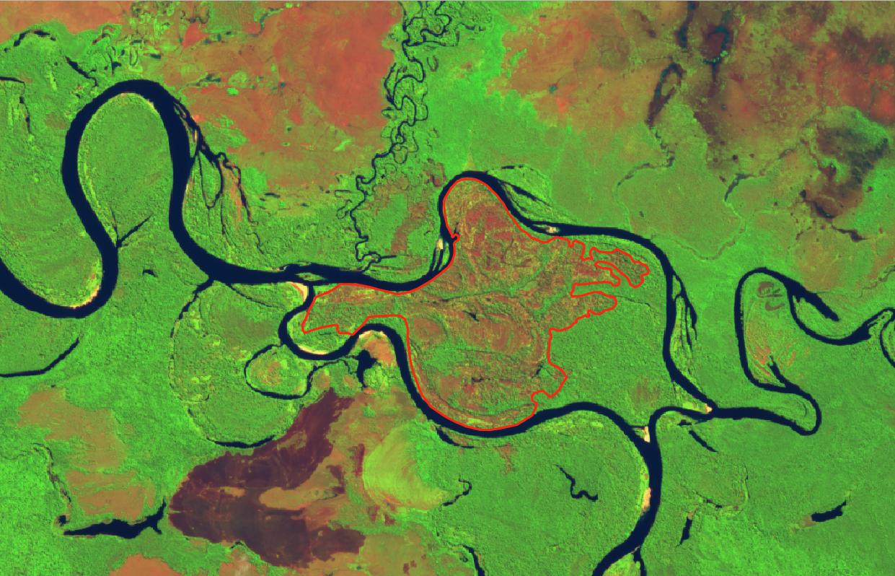
Seasonally-flooded areas
Riparian forests

Slide 18
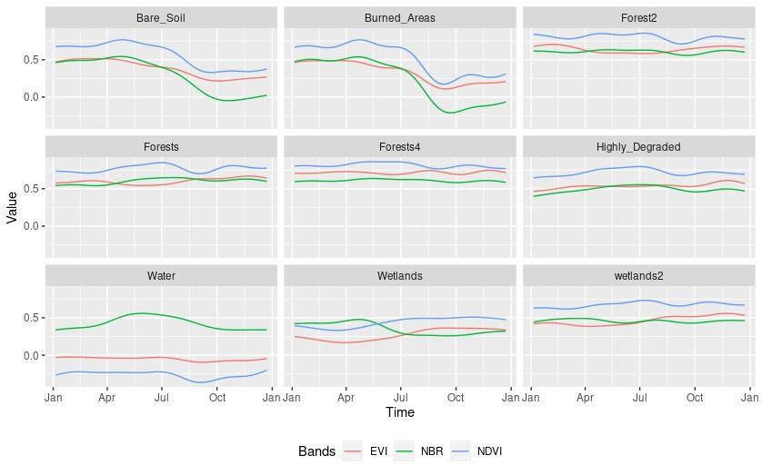
Time series patterns
Clear Cut Bare Soil
Clear Cut Fire
Mountain Side Forest
Forest
Riparian Forest
Clear Cut Vegetation
Water
Seasonally flooded
Wetlands

Slide 19
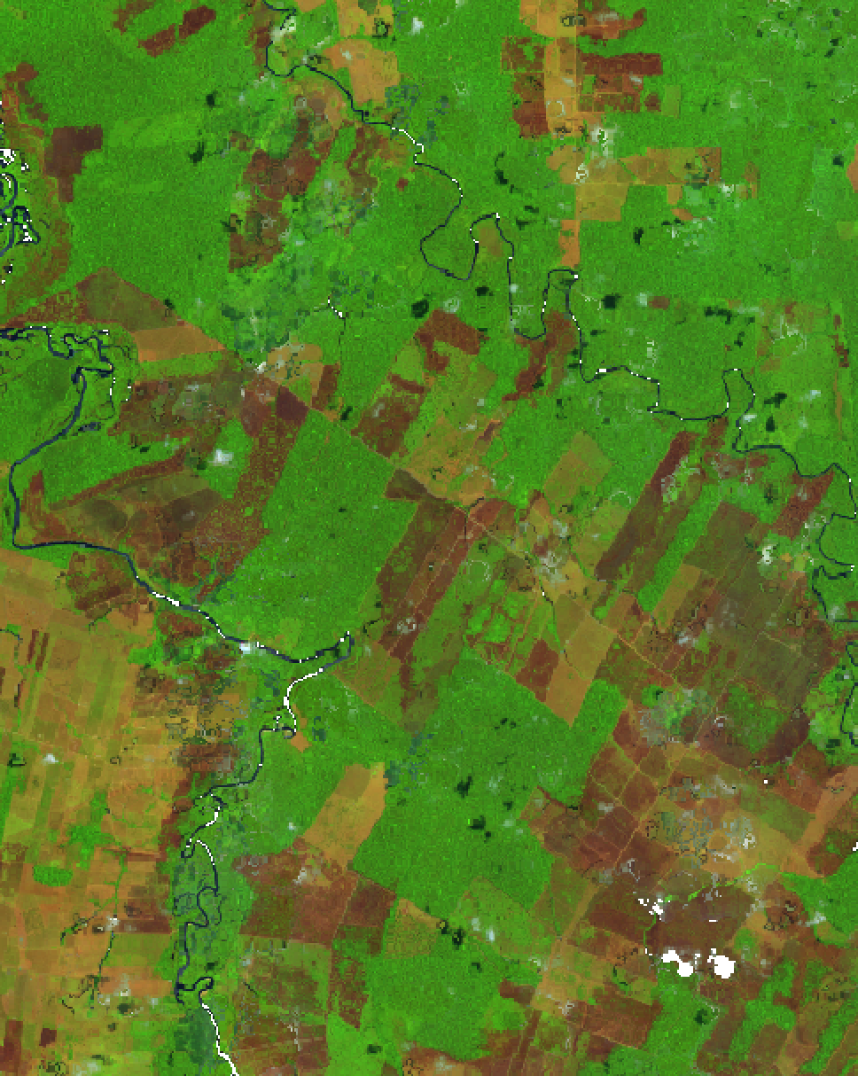
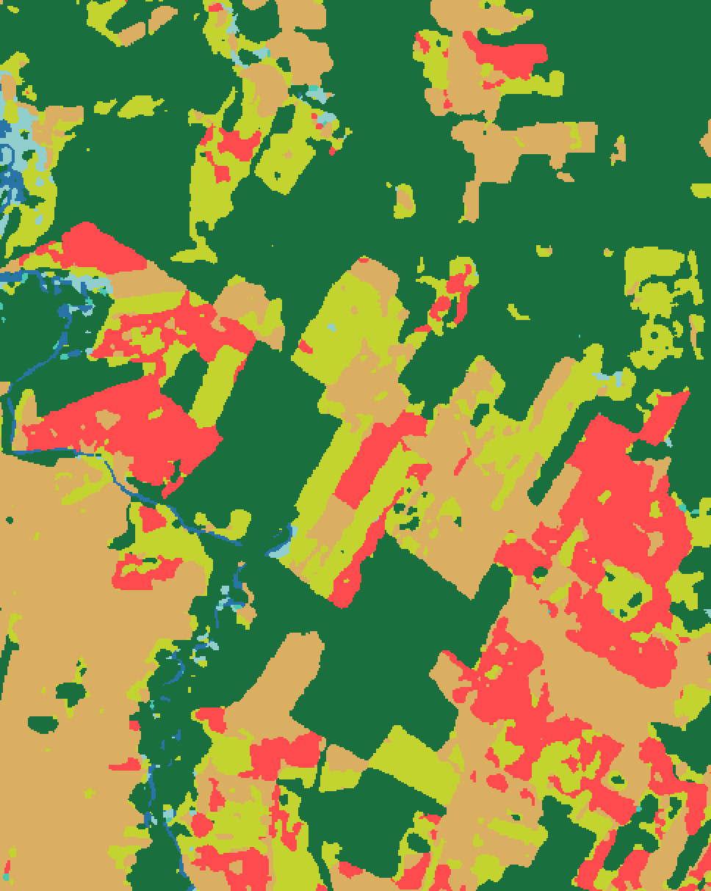
Sentinel-2 (10/2022)
SITS map (2022)

Slide 20
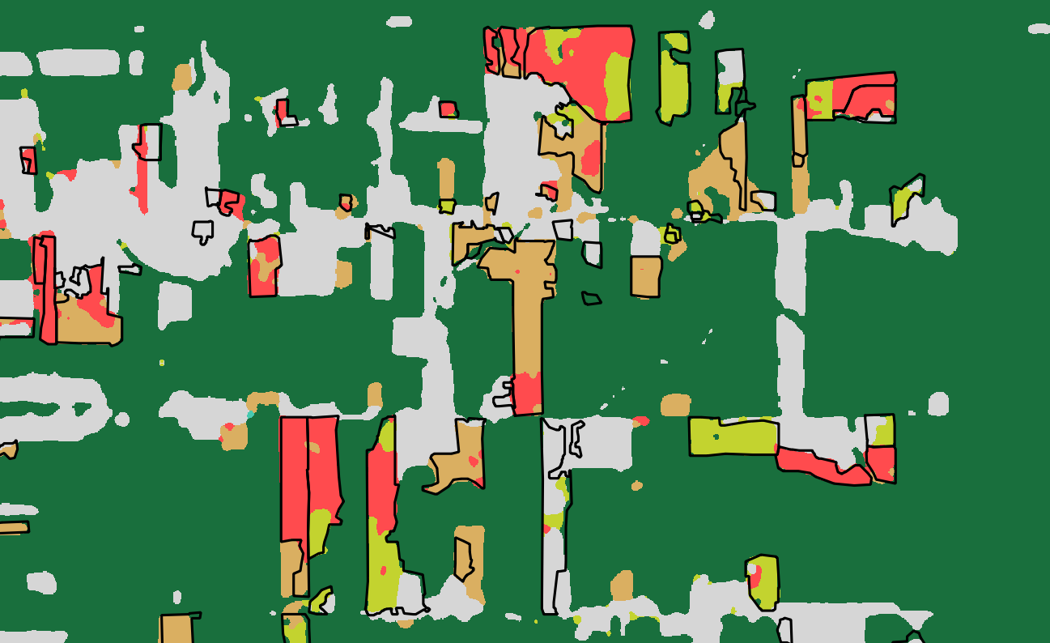
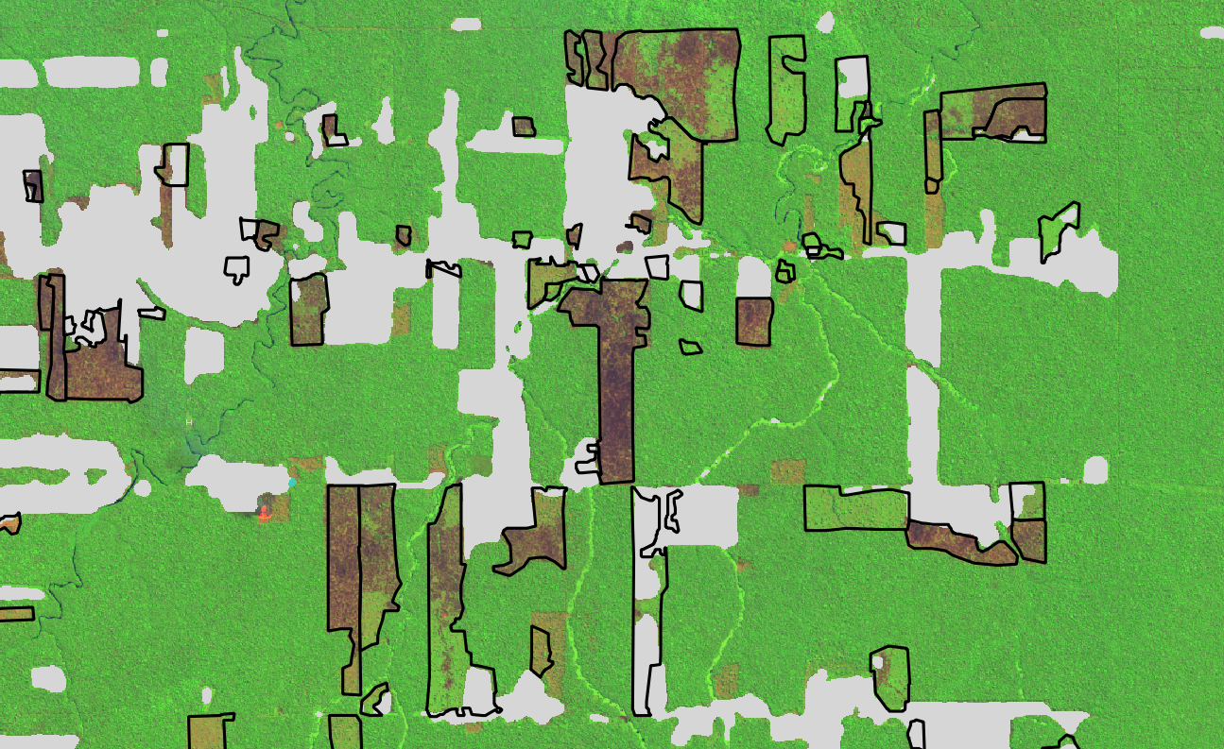
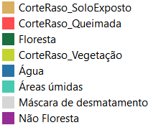
Comparison SITS and visual interpretation
August/2022
95% agreement

Slide 21
Sentinel-2 (10/2022)
SITS map (2022)

Slide 22
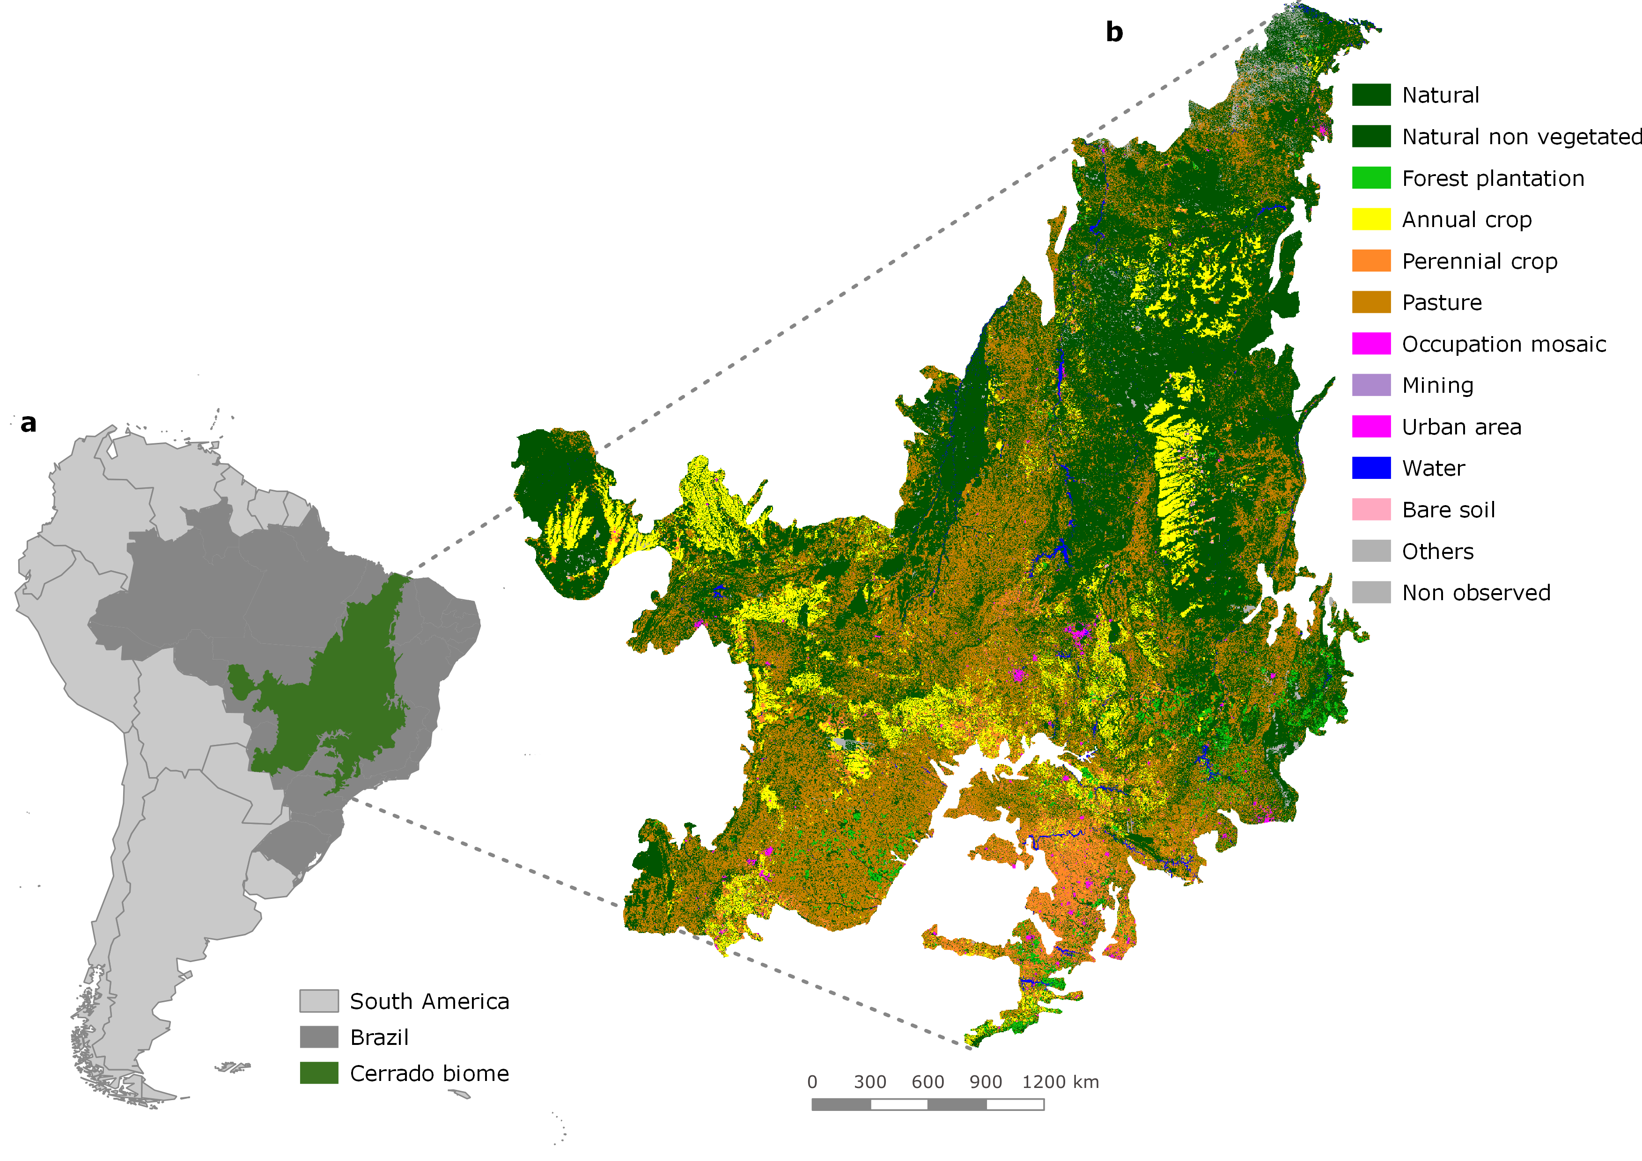
Cerrado: Brazilian Savanna
covers 2 million km², latitude ranges from 5⁰S to 25⁰S

Slide 23
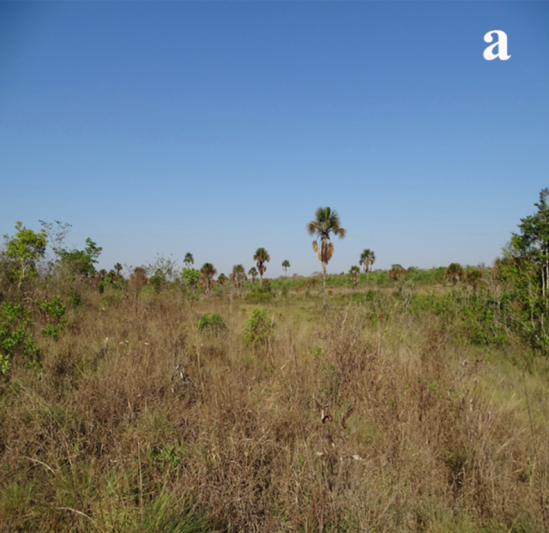
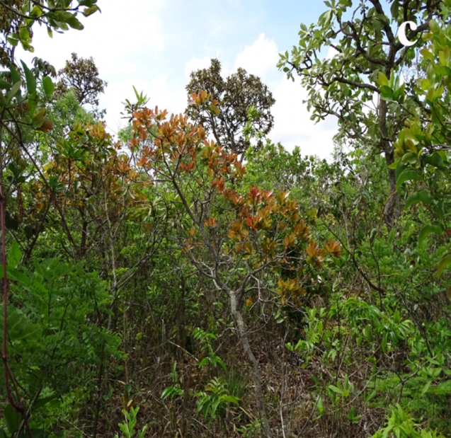
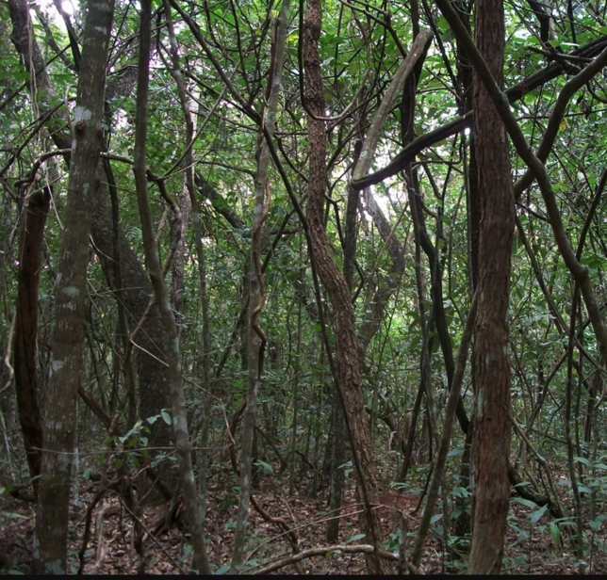
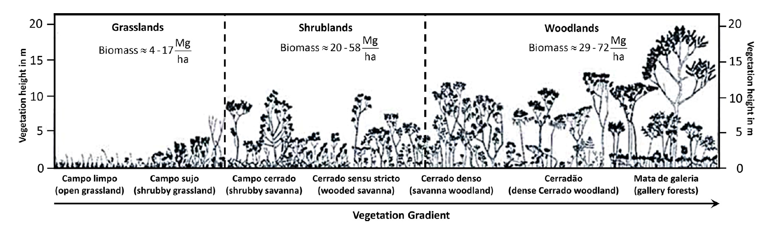
Open cerrado
Cerrado strictu sensu
Cerradão (dense woodland)
images: Del-Claro and Silingardi (Annals Brazilian Academy Sci, 2019 ), Schwieder et al. (IJAEOG, 2016)

Slide 24
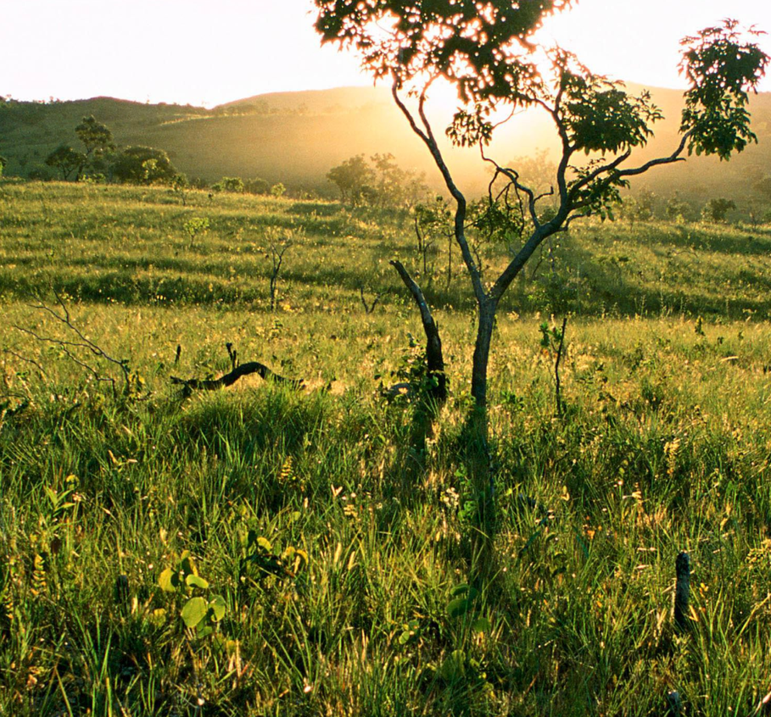
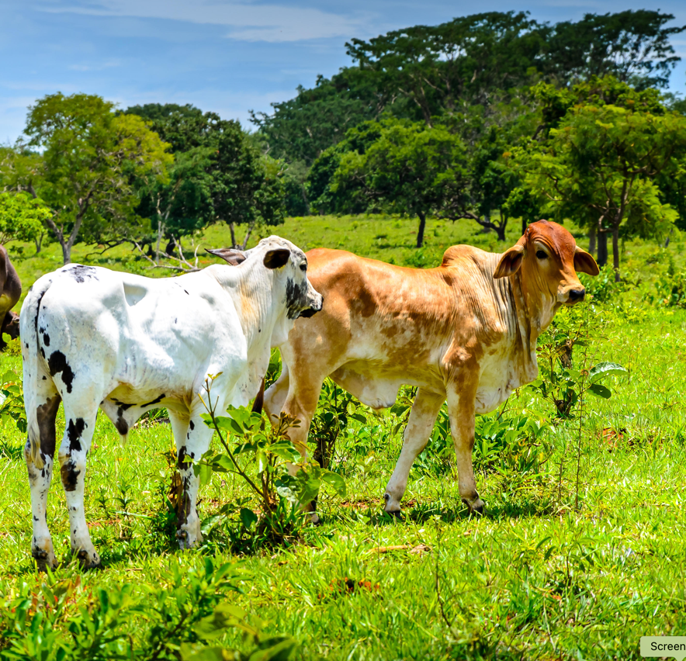
Natural or man-made landscapes?
Natural savanna (Brazilian Cerrado)
Cattle in pasture (in the Cerrado)
images: Nature Conserv, Alamy

Slide 25
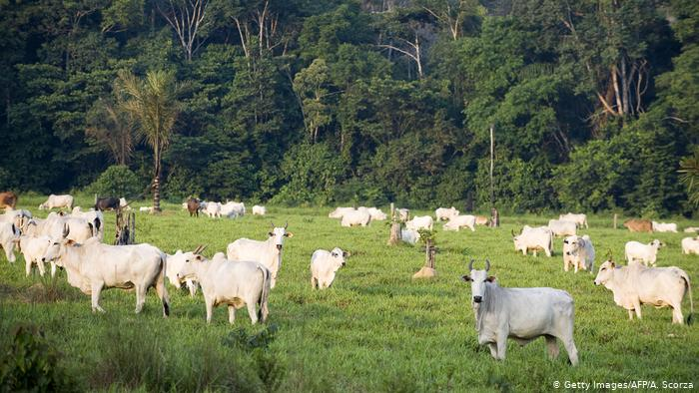
Pasture causes deforestation

Slide 26

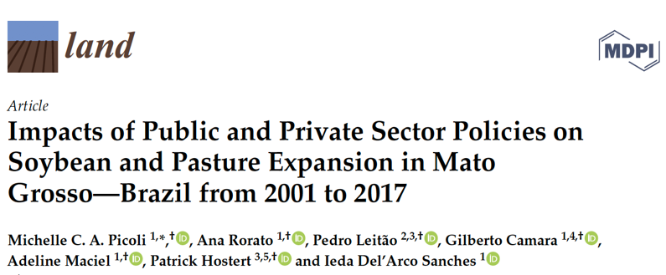
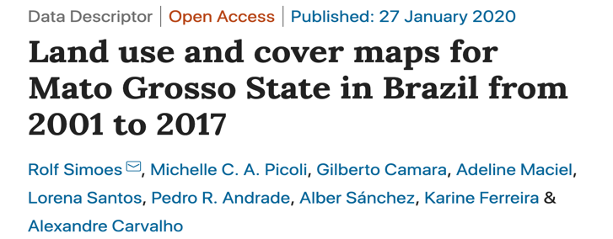
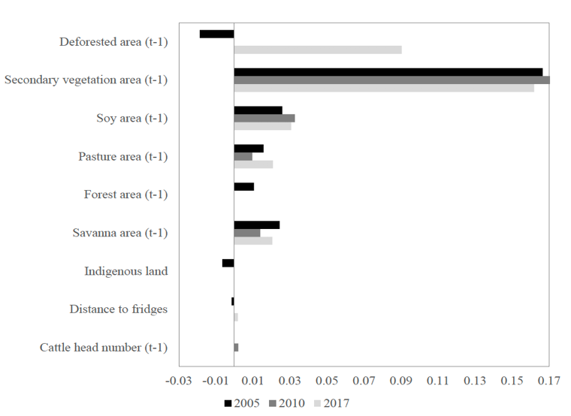
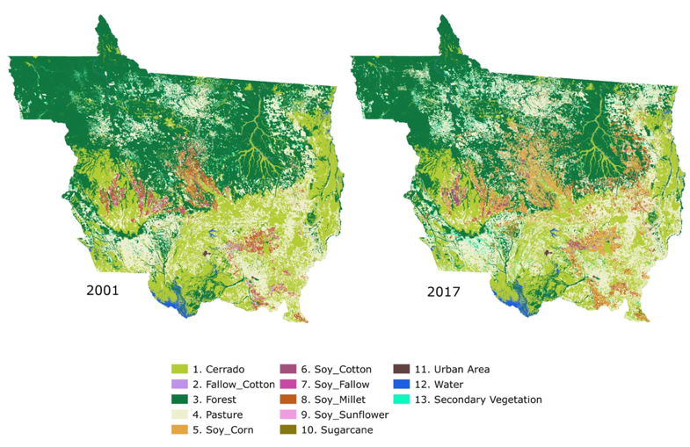
Distinguishing natural and man-made: benefits

Slide 27
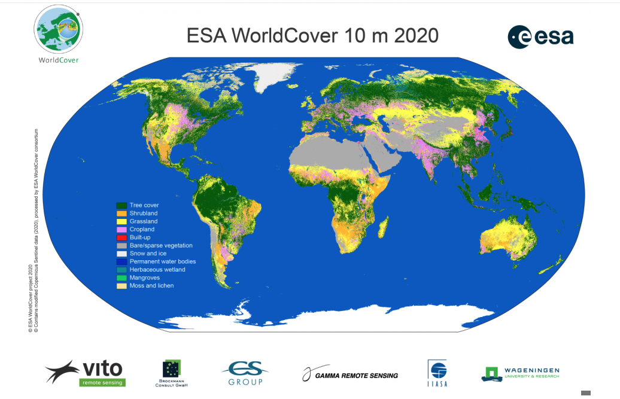
Locally relevant?

Slide 28
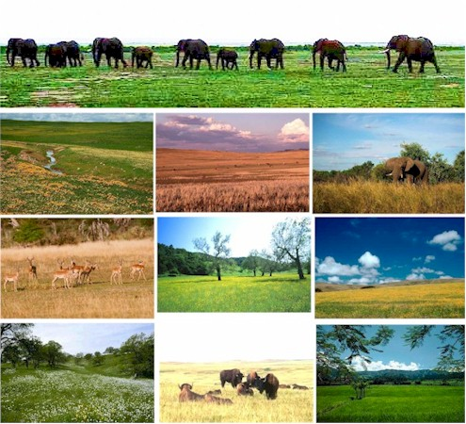
The ambiguity of grasslands

Slide 29
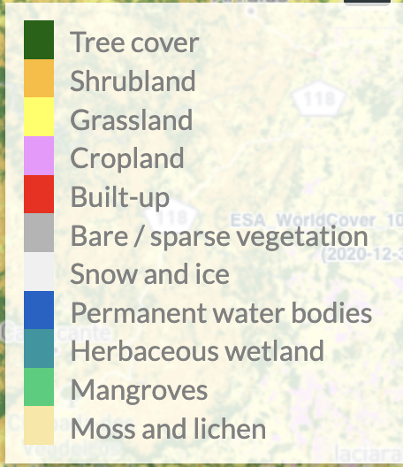
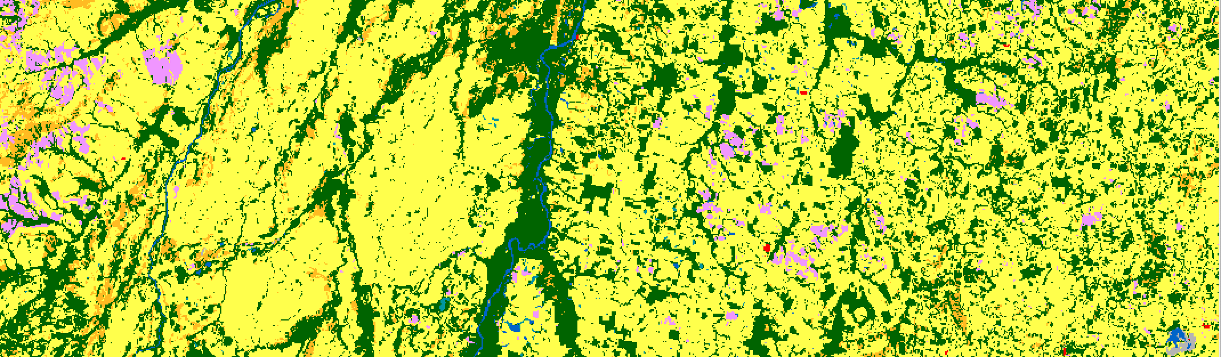
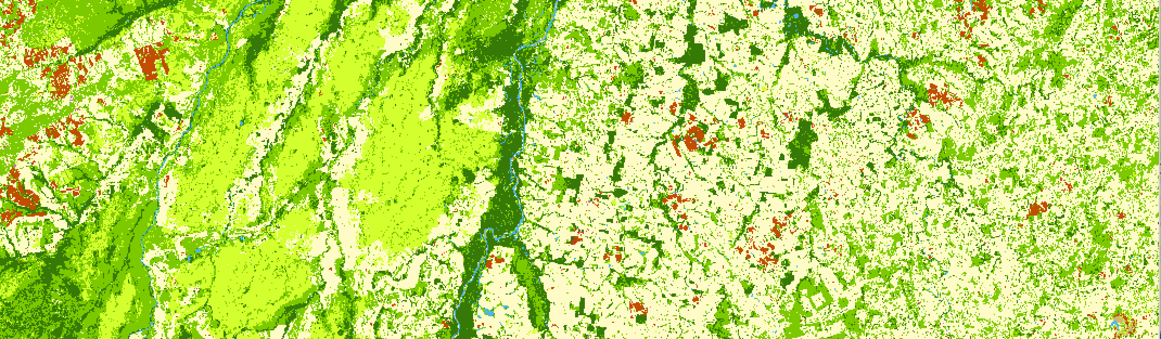

ESA World Cover 2020
Simões et al (2021)

Slide 30

LULC classification
Cerrado biome (200 million ha)
LULC map for year 2018
48,850 samples (TempCNN model)
Landsat-8 16-day time series
8 TB processed in 24 hours
10 LULC classes (86% accuracy)

Slide 31


TerraClass Cerrado 2022
Sentinel-2, 10bands, 10 meter, 16 days, TempCNN method with 87.500 samples, Accuracy: more than 91% UA and PA for core classes.
31
Bertolo (2023)

